Slide 1
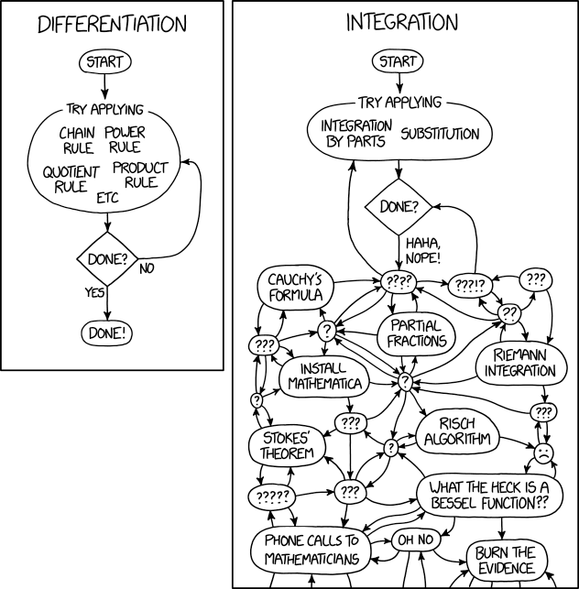
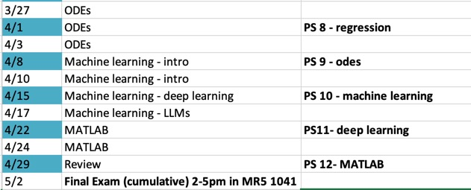
BME 2315: Ordinary Differential Equations 1
Sarah Groves
Adapted from Jeff Saucerman

Slide 2
Outline of next three classes
A little bit of math/definitions
Engineering examples
Numerical methods to solve ODEs: Euler’s method
Practice
Error estimation
Coding
Midpoint method
Practice
Runge Kutta 4th order
Practice and coding

Slide 3
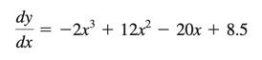
How would you solve this?
$y=−0.5x^{4}+4x^{3}−10x^{2}+8.5x+C$

Slide 4
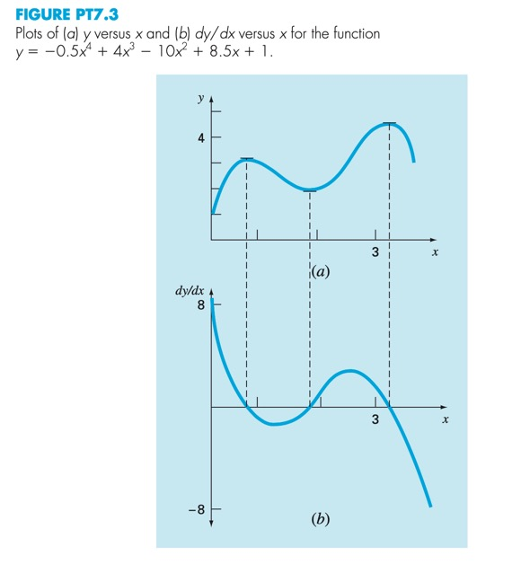
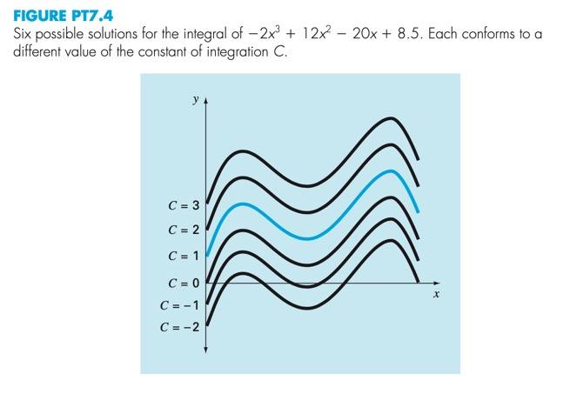
Integration constant → field of solutions

Slide 5
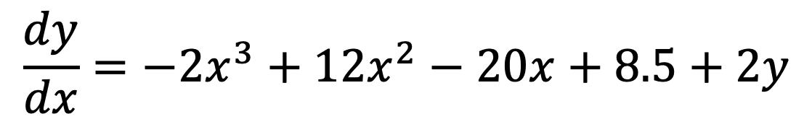
What about if dy/dx also depends on y?
$$\frac{dy}{dx}=−2x^{3}+12x^{2}−20x+8.5+2y$$

Slide 6
Ordinary differential equations (ODEs)
independent variable
dependent variable
A solution is any curve y(x)
that satisfies equation above.
Example:

Slide 7
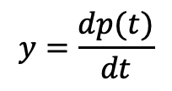
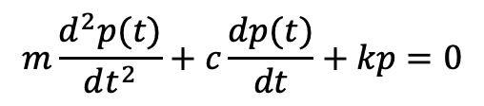
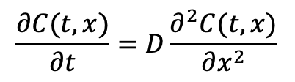
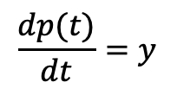
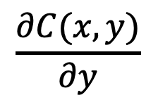
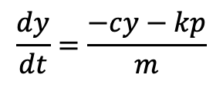
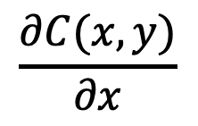
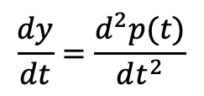
CHANGE IN DEPENDENT VARIABLE WITH RESPECT TO INDEPENDENT VARIABLE
Ordinary Differential Eq.
1 independent variable
Partial Differential Eq.
2+ independent variables
$$\frac{∂C(x,y)}{∂x}$$
$$\frac{∂C(x,y)}{∂y}$$
$$\frac{dy(x)}{dx}=y′(x)$$
$$\frac{∂C(t,x)}{∂t}=D\frac{∂^{2}C(t,x)}{∂x^{2}}$$
$$y=\frac{dp(t)}{dt}$$
$$\frac{dy}{dt}=\frac{−cy−kp}{m}$$
$$\frac{dC}{dt}=k_{p}e^{−t/τ}−k_{d}C$$
$$m\frac{d^{2}p(t)}{dt^{2}}+c\frac{dp(t)}{dt}+kp=0$$
$$\frac{dy}{dt}=\frac{d^{2}p(t)}{dt^{2}}$$
$$\frac{dp(t)}{dt}=y$$
Identify independent and dependent variables

Slide 8
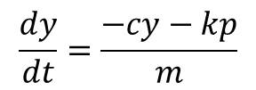
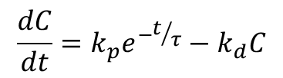
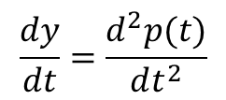
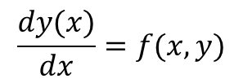
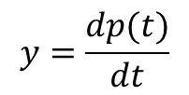
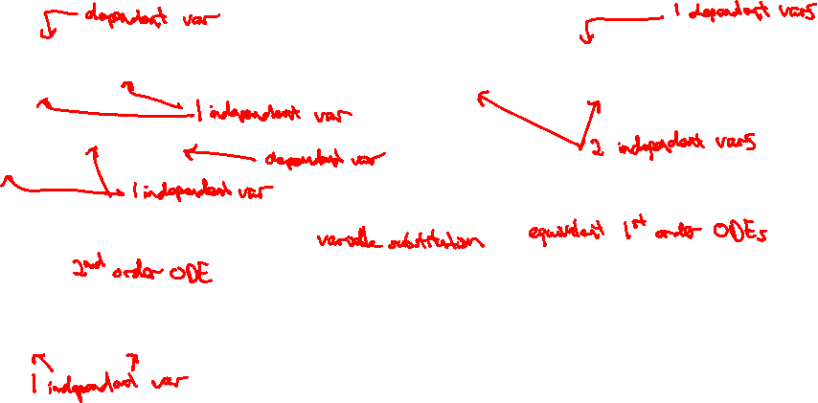
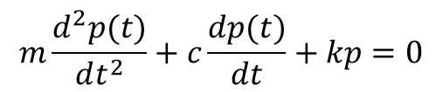
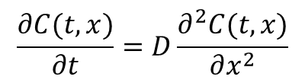
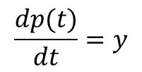
Definition of ODEs
Ordinary Differential Eq.
1 independent var
Partial Differential Eq.
2+ independent vars
$$\frac{dy(x)}{dx}=f(x,y)$$
$$\frac{∂C(t,x)}{∂t}=D\frac{∂^{2}C(t,x)}{∂x^{2}}$$
$$\frac{dC}{dt}=k_{p}e^{−t/τ}−k_{d}C$$
$$y=\frac{dp(t)}{dt}$$
$$\frac{dy}{dt}=\frac{−cy−kp}{m}$$
$$m\frac{d^{2}p(t)}{dt^{2}}+c\frac{dp(t)}{dt}+kp=0$$
$$\frac{dp(t)}{dt}=y$$
$$\frac{dy}{dt}=\frac{d^{2}p(t)}{dt^{2}}$$

Slide 9
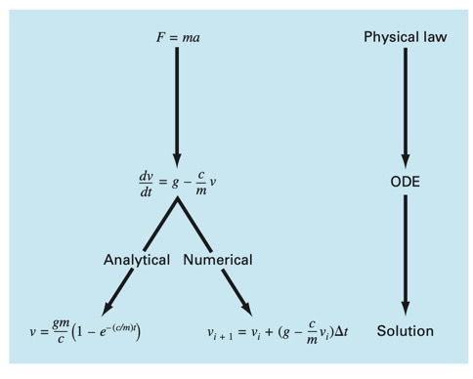
Why?
modeling

Slide 10
Example: compartmental models
COMPARTMENT
in
out
BME Applications
Reaction Kinetics: drugs, enzyme-ligand
Mass/Energy Transfer: blood flow, epidemiology

Slide 11
How do we solve ODEs?
1) Guessing
E.g.: exponential growth/decay

Slide 12
How do we solve ODEs?
2) Separation of variables
example

Slide 13
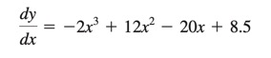
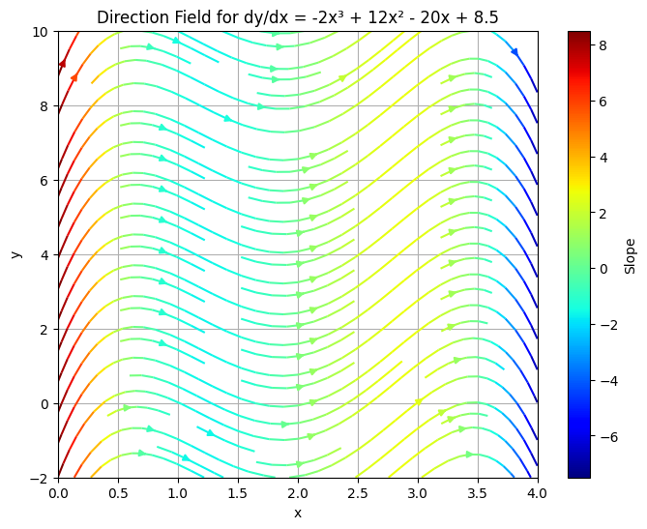
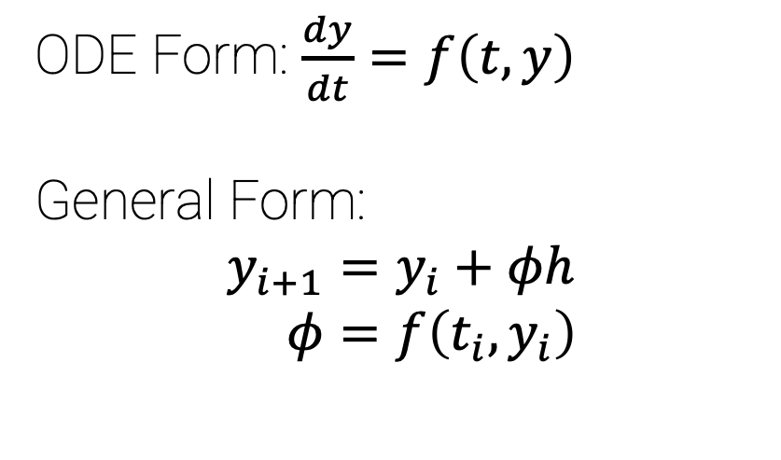
How do we solve ODEs?
The initial condition at x = 0 is y = 1.
We know:
y’=f(x) at any x, including y_{i}’ and y_{i+1}’
y(x_{i}) = y_{i}
We don’t know:
- y(x_{i+1}) = y_{i+1}
3. Numerical methods
ODE Form: $\frac{dy}{dt}=f\left(t,y\right)$
General Form:
$$y_{i+1}=y_{i}+φh \\ φ=f\left(t_{i},y_{i}\right)$$
True solution
Euler’s method
Where have you seen this equation before?
y_{i+1}=y_{i}+y_{i}’*h

Slide 14
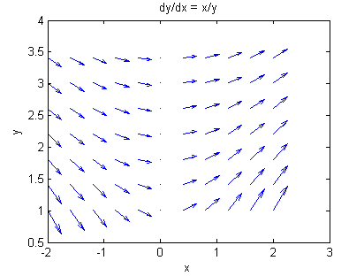
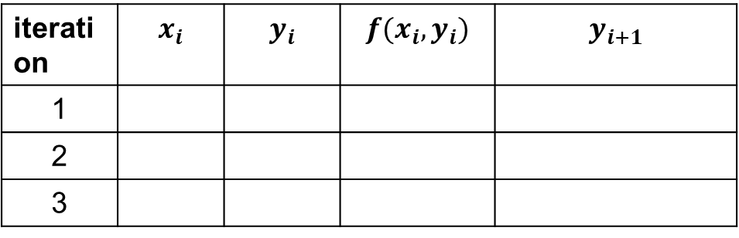
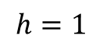
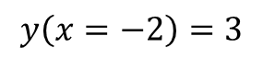
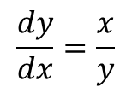
Euler’s Method Example
$$\frac{dy}{dx}=\frac{x}{y}$$
Solve y(x) using Euler’s method.
I.C.
$$y\left(x=−2\right)=3$$
$$h=1$$
iteration | $$x_{i}$$ | $$y_{i}$$ | $$f(x_{i},y_{i})$$ | $$y_{i+1}$$
1
2
3

Slide 15
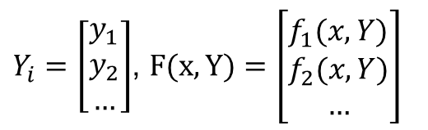
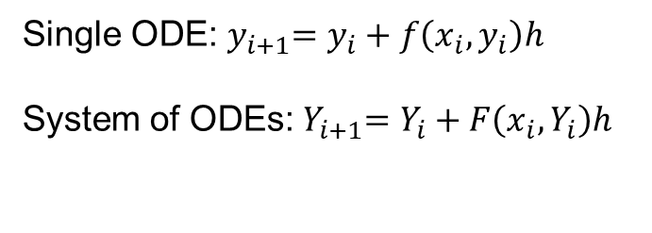
Euler’s Method for systems of ODEs
Single ODE:${ y}_{i+1}=y_{i}+f\left(x_{i},y_{i}\right)h$
System of ODEs:${ Y}_{i+1}=Y_{i}+F\left(x_{i},Y_{i}\right)h$
$Y_{i}=\left[\begin{matrix}y_{1} \\ y_{2} \\ …\end{matrix}\right]$, $F(x,Y)=\left[\begin{matrix}f_{1}(x,Y) \\ f_{2}(x,Y) \\ …\end{matrix}\right]$

Slide 16
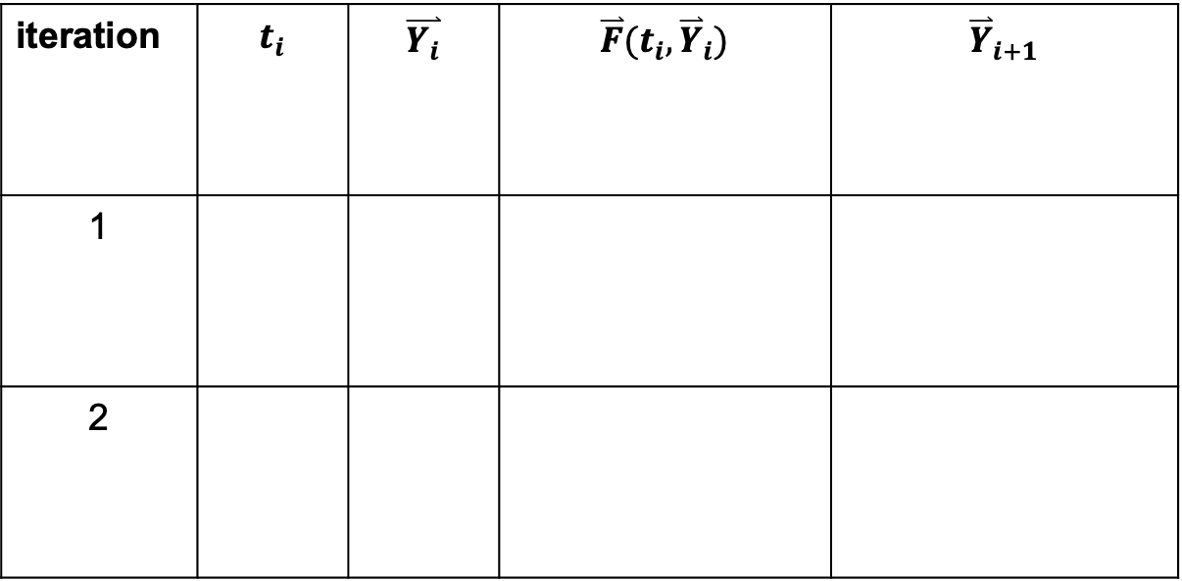
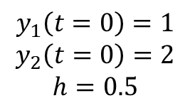
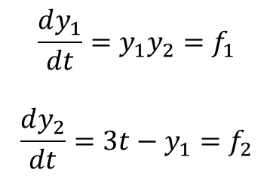
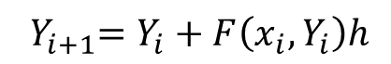
System of ODEs example
$$\frac{dy_{1}}{dt}=y_{1}y_{2}=f_{1}$$
$$\frac{dy_{2}}{dt}=3t−y_{1}=f_{2}$$
$${ Y}_{i+1}=Y_{i}+F\left(x_{i},Y_{i}\right)h$$
iteration | $$t_{i}$$ | $$\overset{⃑}{Y_{i}}$$ | $$\overset{⃑}{F}(t_{i},{\overset{⃑}{Y}}_{i})$$ | $${\overset{⃑}{Y}}_{i+1}$$
1
2
I.C.s
$$y_{1}\left(t=0\right)=1$$
$$y_{2}\left(t=0\right)=2$$
$$h=0.5$$

Slide 17
Euler’s method practice!

Slide 18
Taylor Series error estimate for Euler’s Method
Local error: error at t_{i+1} from t_{i}
Global error: error at time t after how many steps it takes to get there from t0
Notes:
$$y_{i+1}=y_{i}+f\left(t_{i},y_{i}\right)h$$
$$y(t+h)=y(t)+f\left(t,y(t)\right)h$$
$$y\left(t+h\right)=y\left(t\right)+\frac{h}{1!}f\left(t,y\left(t\right)\right)+\frac{h^{2}}{2!}f^{′}\left(t,y\left(t\right)\right)+…$$
Global Truncation error- error at a fixed time t after how many steps it takes to get there.
The number of steps it takes to estimate t starting from t0 is (t-t0)/h
1/h * h^2 -> h global error
Improve solution with smaller h

Slide 19
Python code for Euler’s method
# eulers.py
import numpy as np
def eulers(ODEfunc,tspan,y0,h):
return t,y

Slide 20
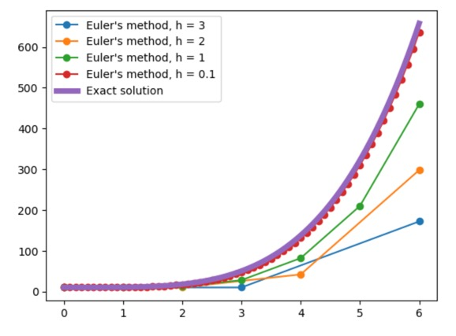
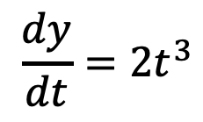
Why are the predictions for y_{i+1} underestimating the true value?
$$\frac{dy}{dt}=2t^{3}$$

Slide 21
Key Points
ODEs can be used to model many different biological systems
Euler’s Method
Approximate solution using slope at current location
Error depends on step size
Extend directly to a system of ODEs

